Slide 1
Magician’s Image Caption
Jack Yu Jiahao Guo Yiqun Fan

Slide 2
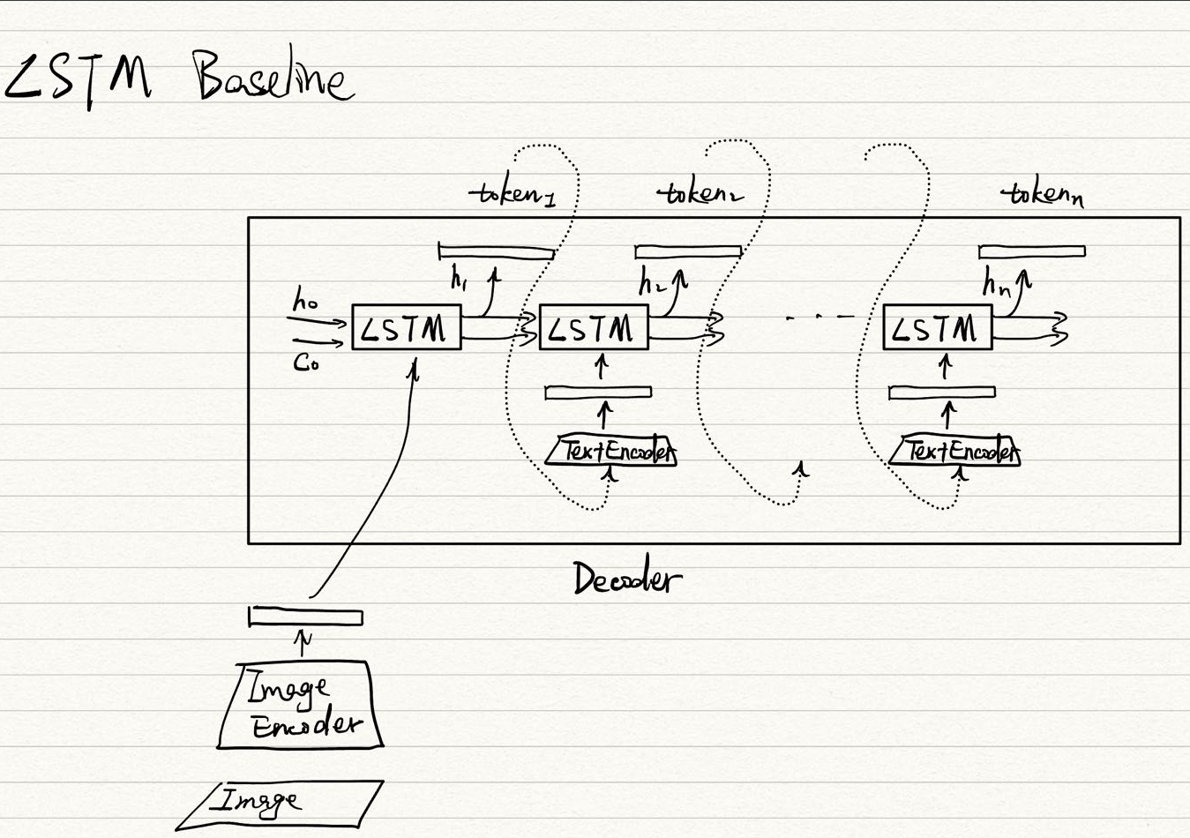
This is a LSTM

Slide 3
Result

Slide 4
Lesson Learned so far

